Slide 1
Case Study
PEr scholas Use case study Project
“Producebargain”
Notes:
User Stories:
As a user I want to register my account so that i can use the application.
As a registered user I want to log onto my account so that I can use the application.
As a registered user I want to see products available so that I can select the ones I want.
As a registered user I want to select the products I want so that I can add them to my cart.
As a registered user I want to add a product to my cart so that the item will be added to my order.
As a registered user I want to remove product to my cart so that it will not be part of my order.
As a registered user I want to check out so that I can place a reservation .
As a supplier I want to register my account so that i can use the application.
As a registered supplier I want to log onto my account so that I can use the application.
As a registered supplier I want to add product so that I can make it available to users.
As a registered supplier I want to update product information so that I can update changes to inventory of the object.
As an administrator I want to update user account so that I can add a new user to the app.
As an administrator I want to delete account so that I can prevent a user from logging into the app.

Slide 2




Reduce Food Waste and promote healthy eating
There is more than enough food produced in the world to feed everyone on the planet.
815 million people worldwide go to bed hungry each night. (Action Against Hunger Stats)
Supermarkets throw away 43 billion pounds of food every year (CNBC)
Most people know that fruits and vegetables are good for them, yet few consume recommended amounts.
One barrier is that many believe that healthy food is more expensive than unhealthy food. (Center for Science in the Public Interest)
ProduceBargain.com provides a platform for supermarkets and suppliers to make available affordable produce to low income families at a substantial discount.
Notes:
https://www.dumpsters.com/blog/grocery-store-food-waste-statistics

Slide 3
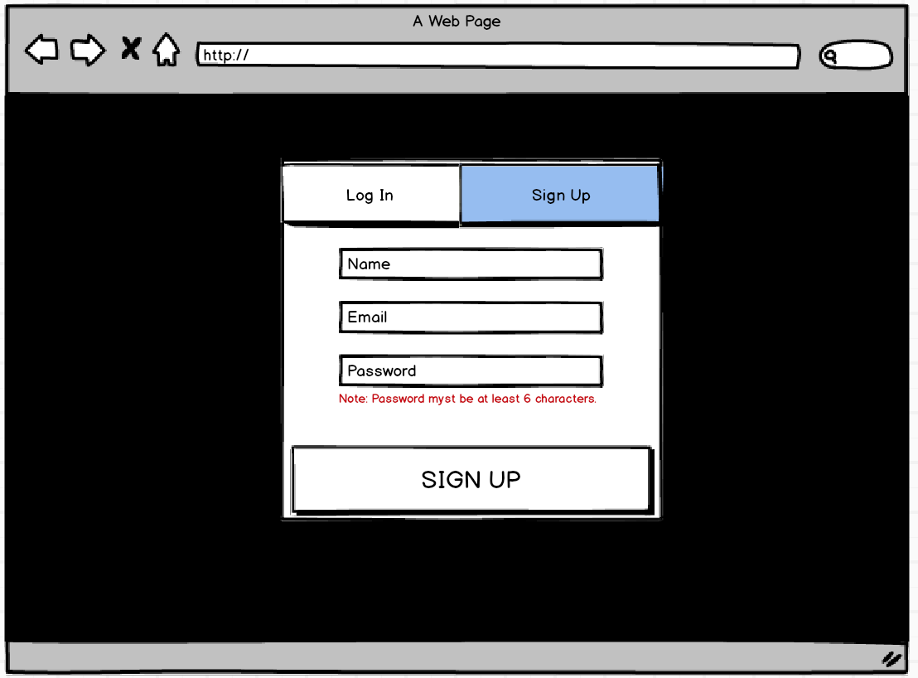
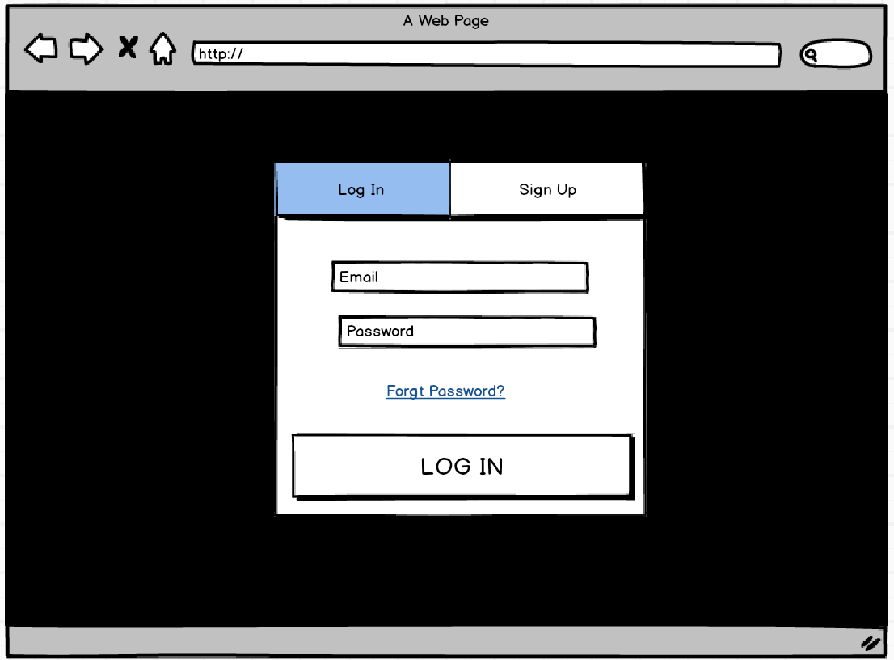
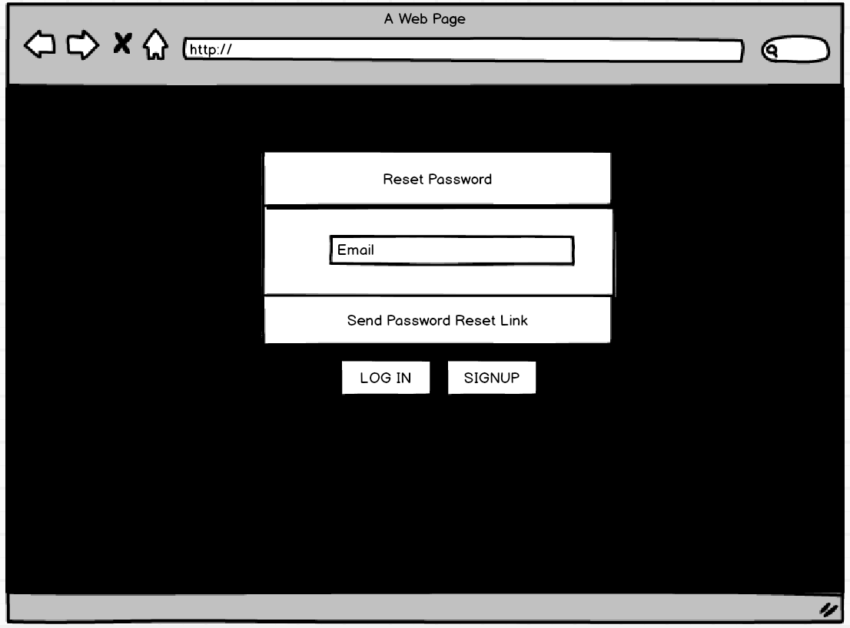
User stories: Login
As a user I want to register / Sign-Up for an account so that I can use the application.
As a supplier I want to register / Sign-Up for an account so that I can use the application.
As a registered user I want to log-in to my account so that I can use the application.
As a registered supplier, I want to log-in to my account so that I can use the application
As a registered user I want to reset my password when I forget my password.

Slide 4
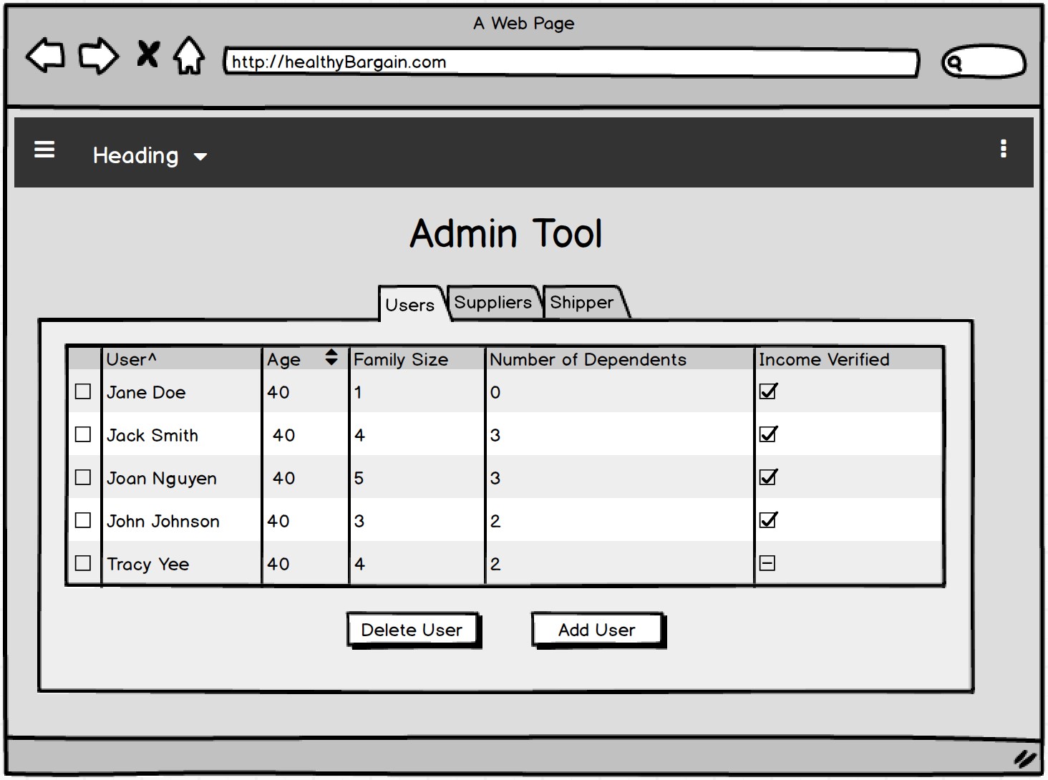
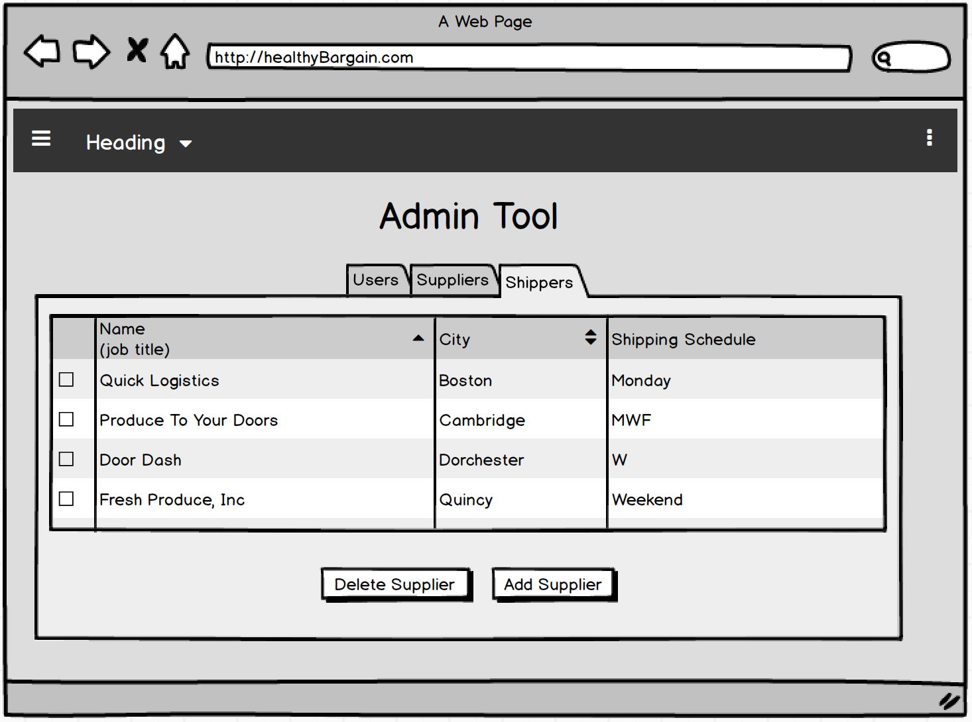
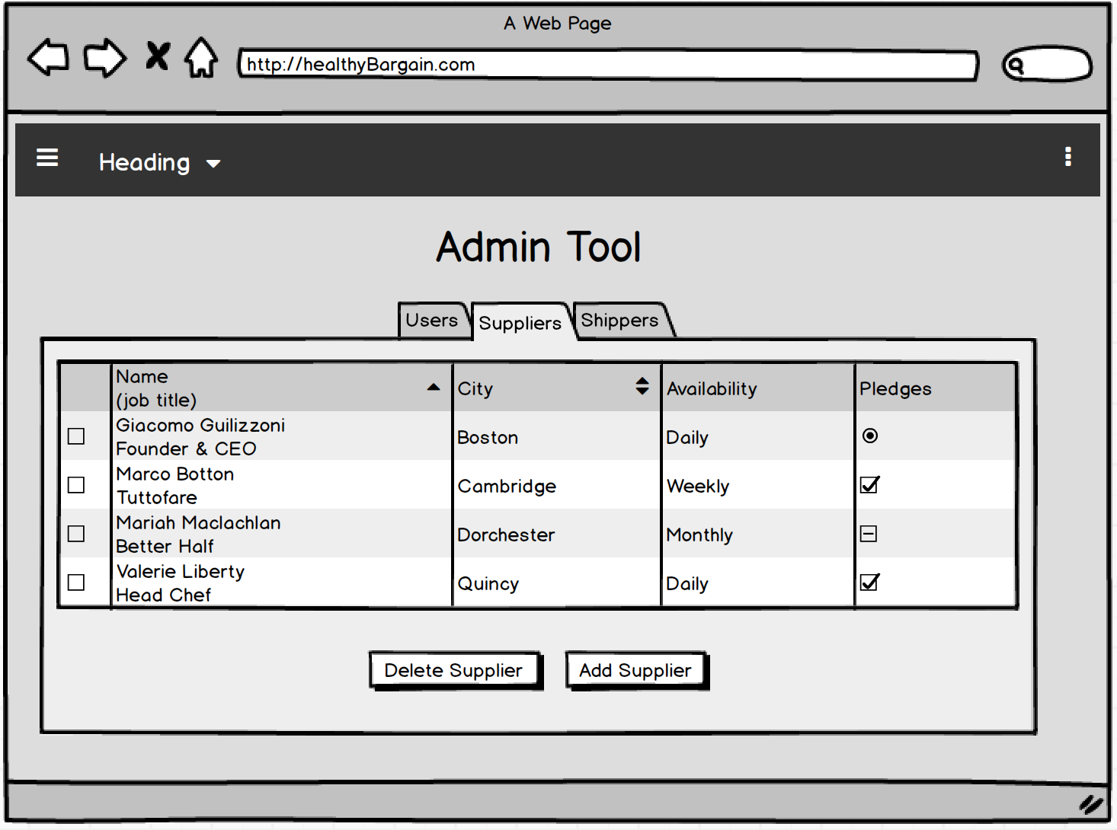
User Stories: Admin User
As an administrative User I want to update user account so that I can add a new and delete user.
As an administrative User I want to update user account so that I can add a new and delete Suppliers.
As an administrative User I want to update user account so that I can add a new and delete Shippers.

Slide 5
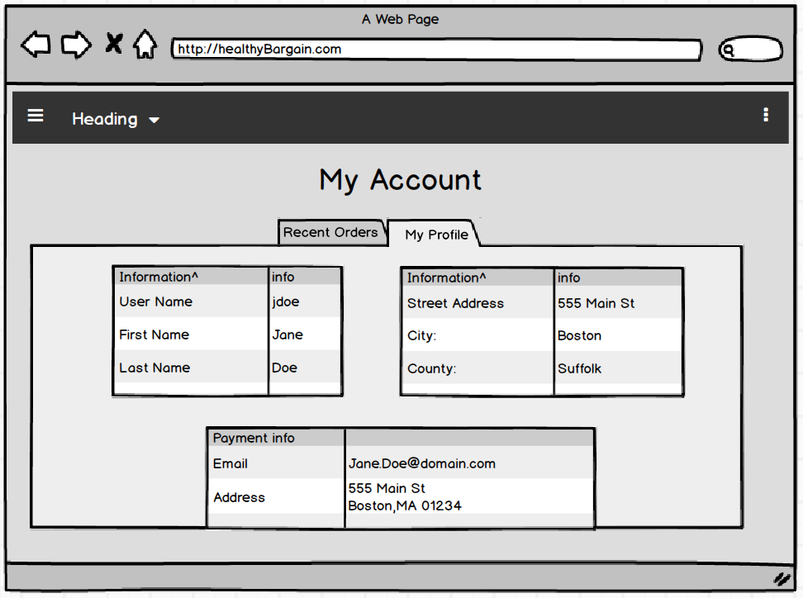
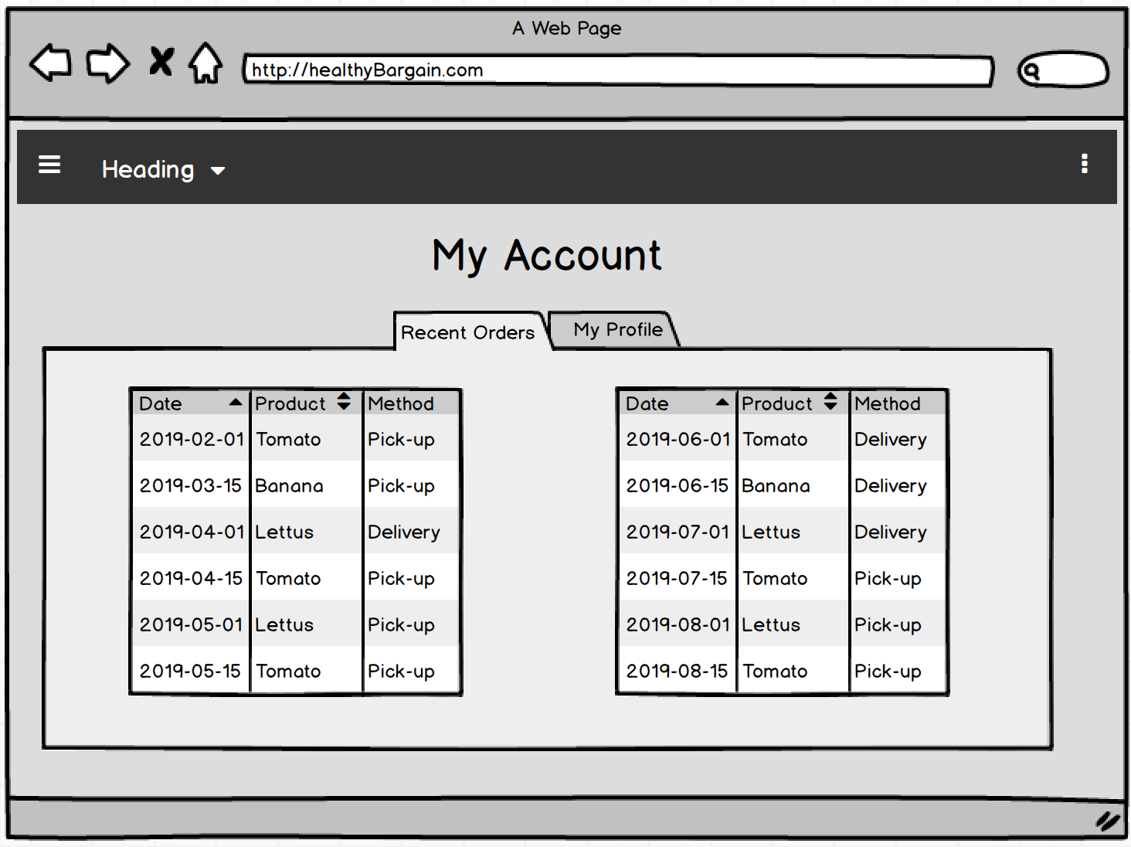
User Story: User Profile
As an registered User I want to view my profile so that I can update my information.
As an registered User I want to view order history so I can keep track my order history.

Slide 6
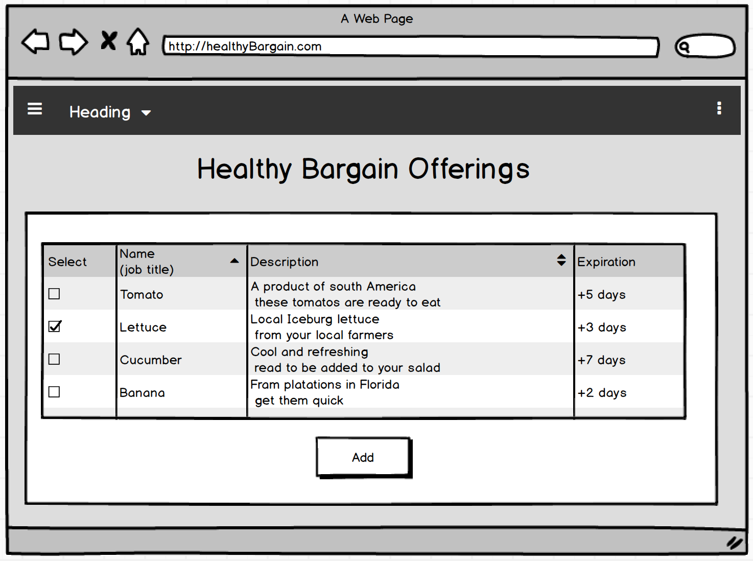
User Story: Select Item(s)
As a registered user I want to see products available so that I can select the ones I want.
As a registered user I want to select the products I want so that I can add them to my cart.
As a registered user I want to add a product to my cart so that the item will be added to my order.

Slide 7
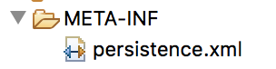
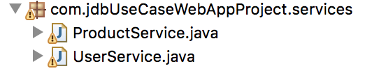
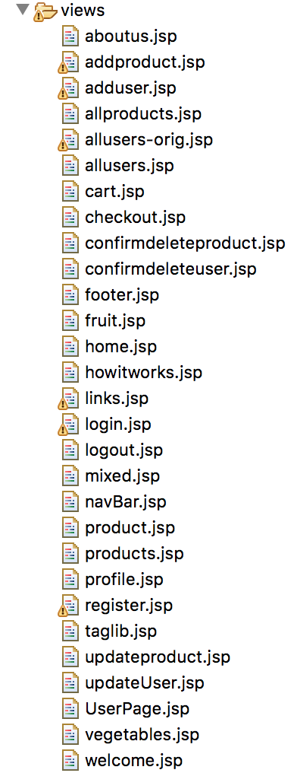
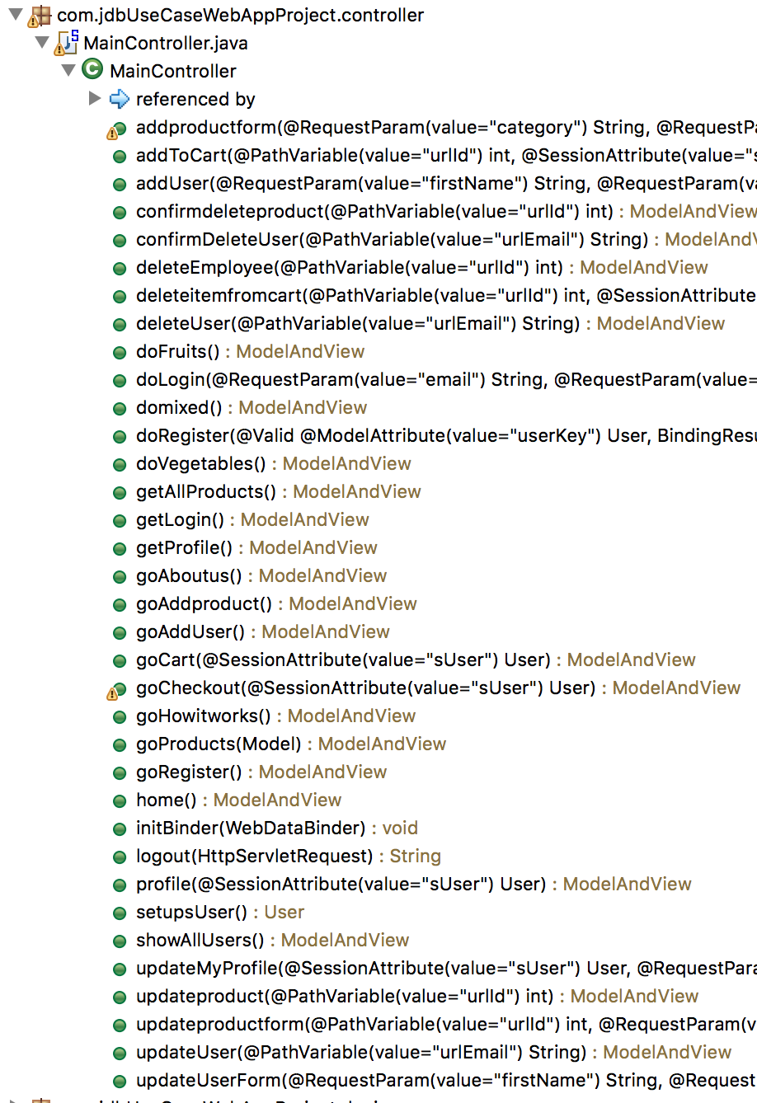
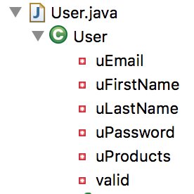
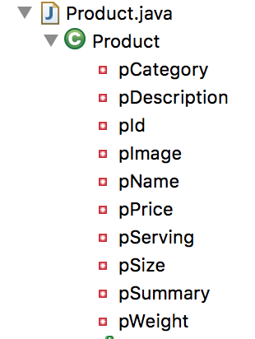
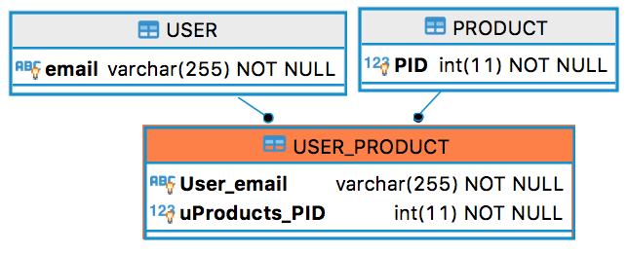
Spring MVC
JPA
Spring Controller Layer
Spring Model Layer
Services
View Layer

Slide 8
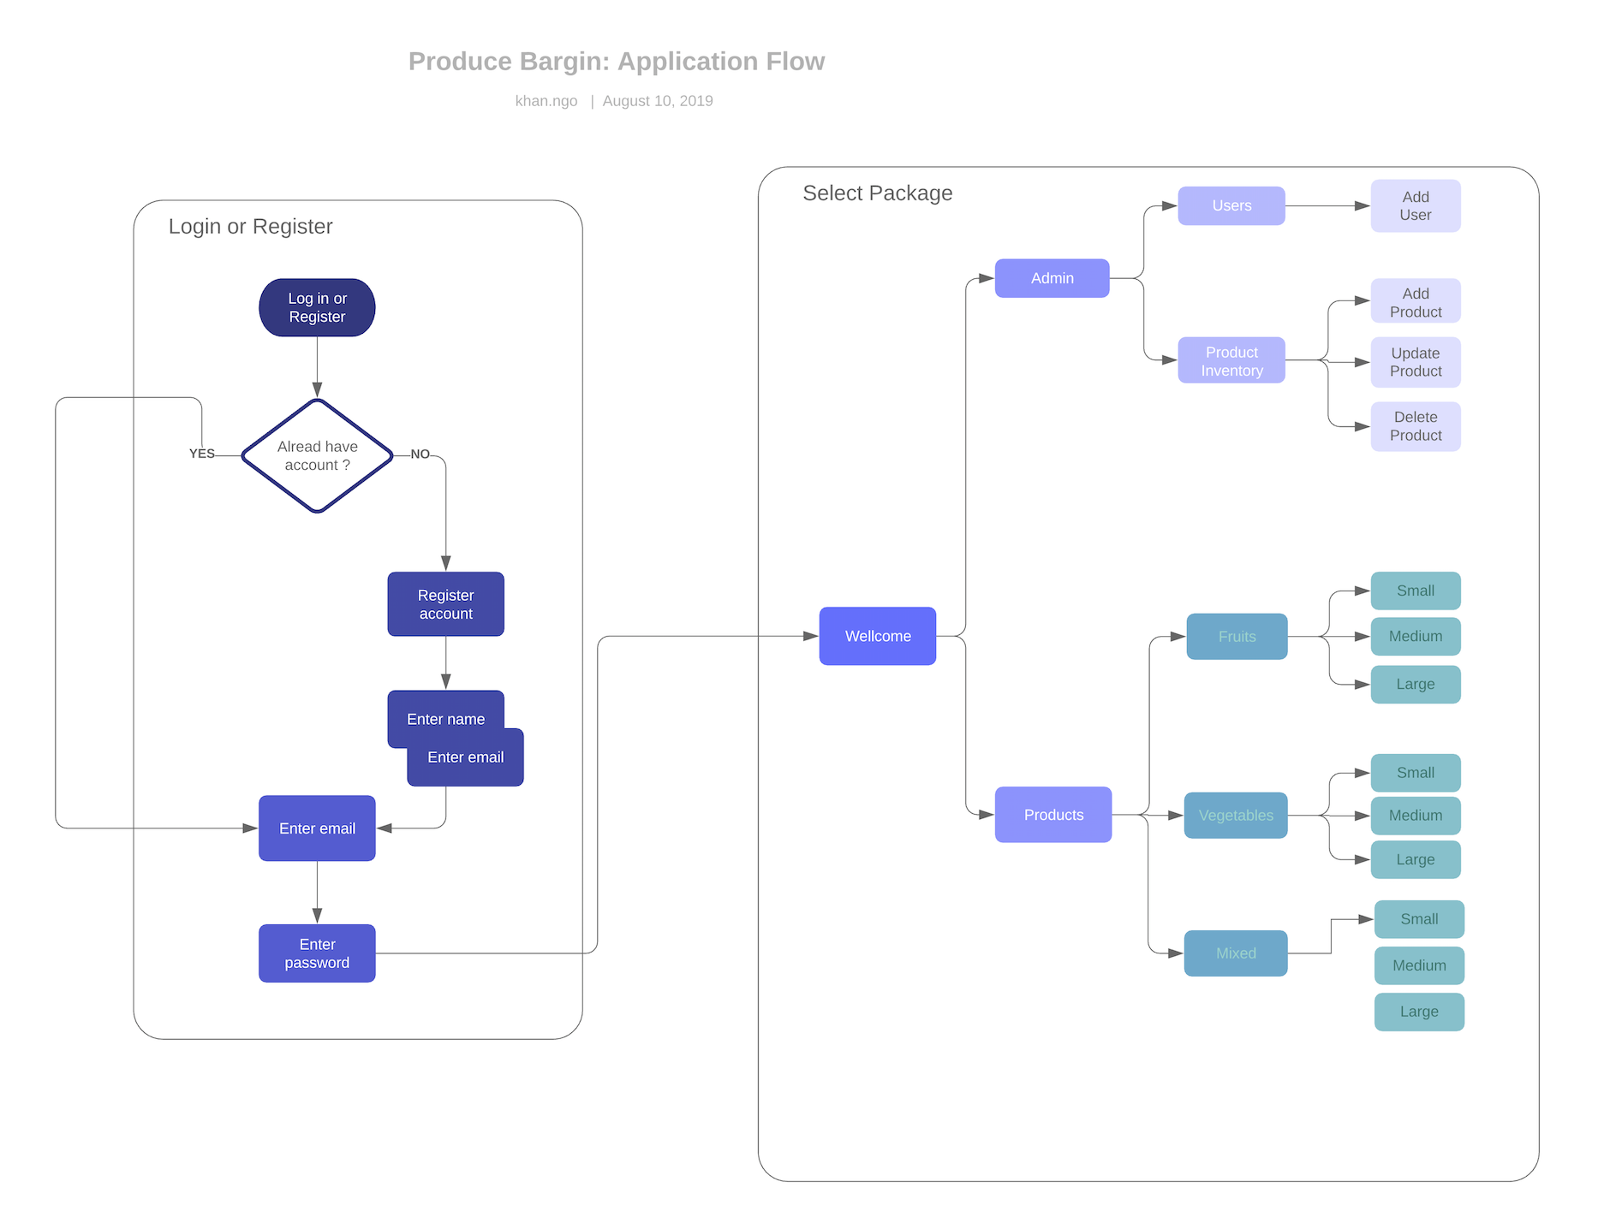
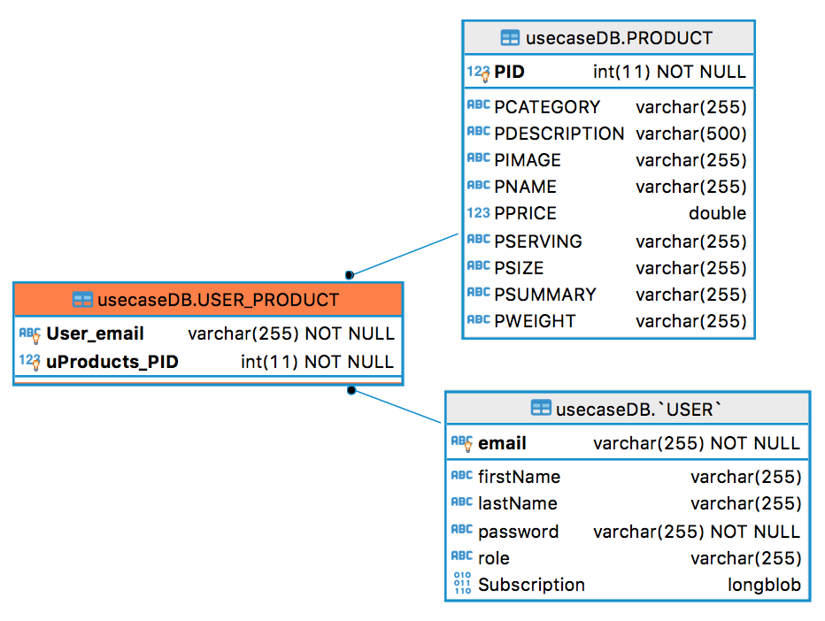
UML - ERD
Entity Relationship Diagram
(ERD)

Slide 9

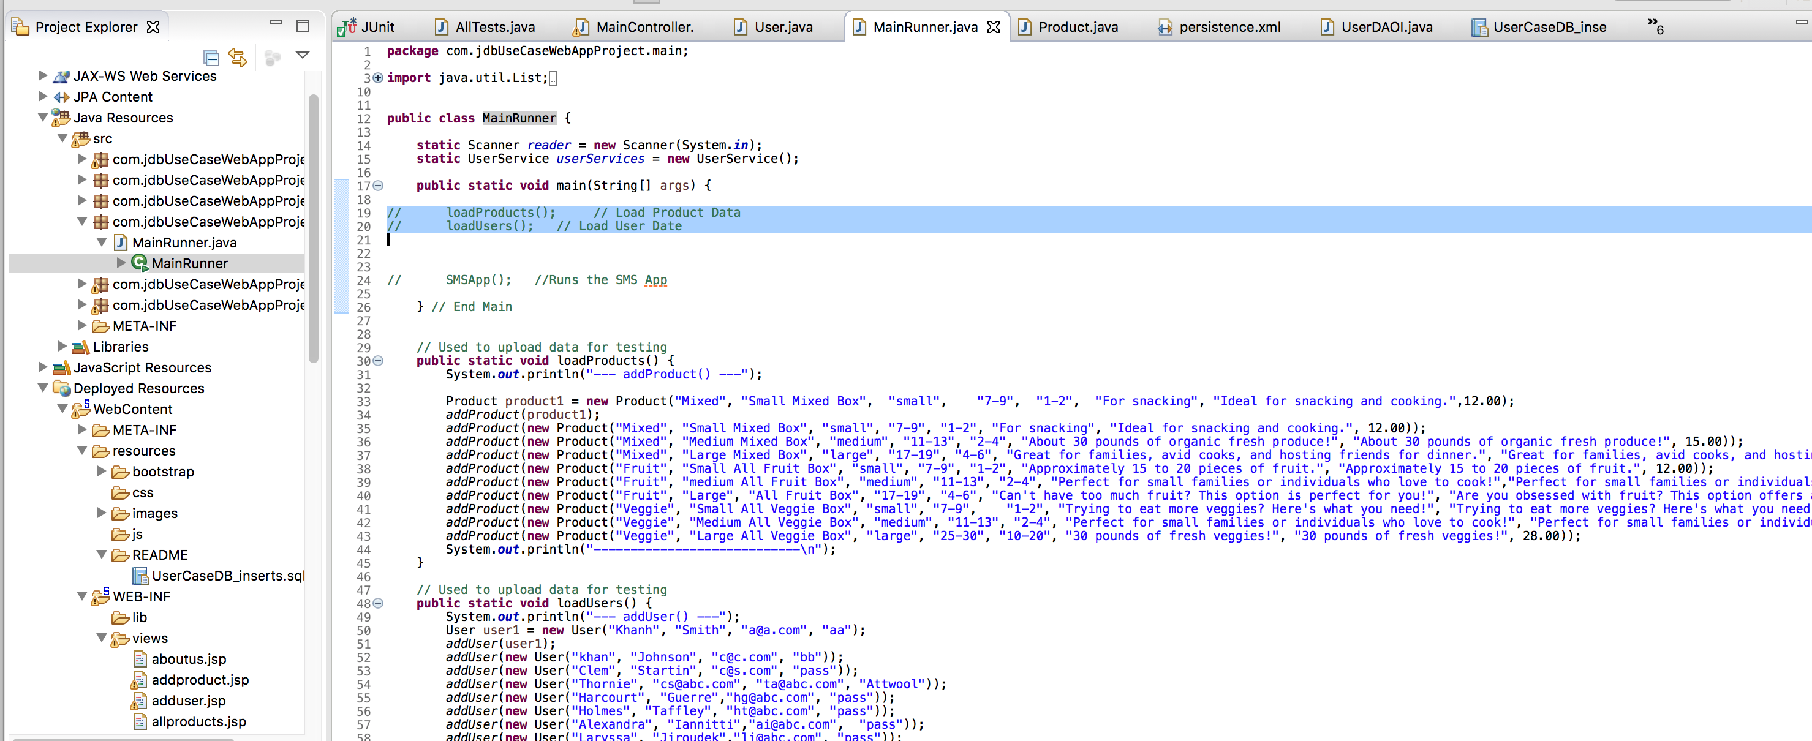
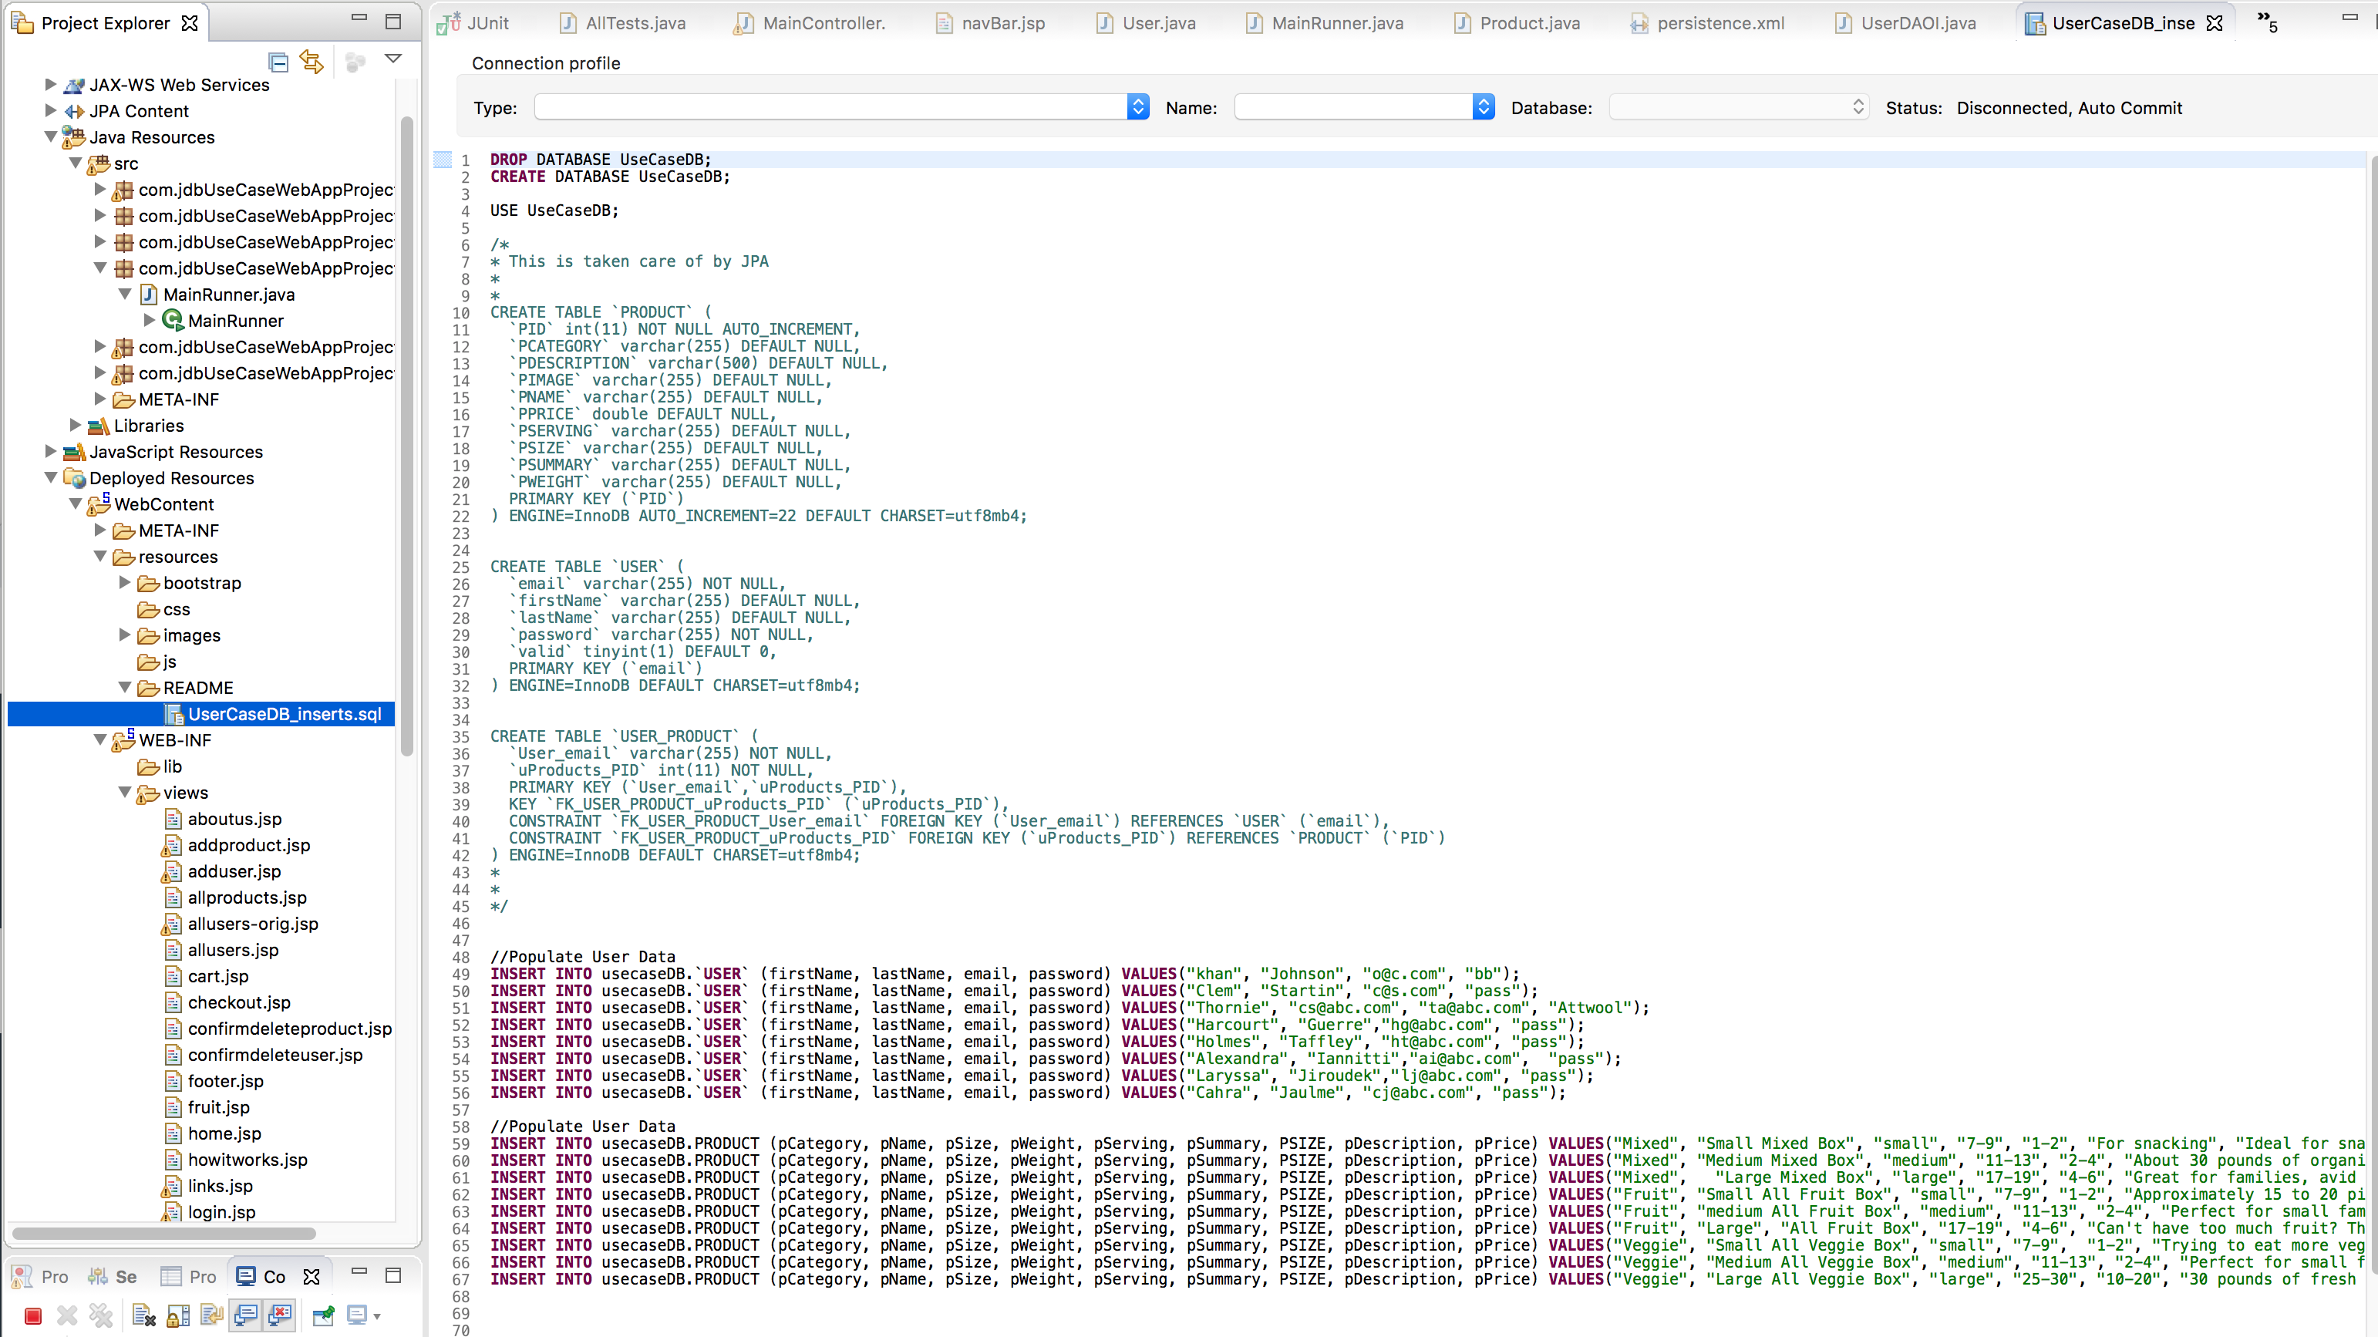
Import Data
To load data to UseCaseDB via Applicaiton
com.jdbUseCaseWebAppProject.main.MainRunner.main
loadProducts();
loadUsers();
To load data to UseCaseDB via Applicaiton
com.jdbUseCaseWebAppProject.main.MainRunner. README/UserCaseDB_inserts.sql

Slide 10
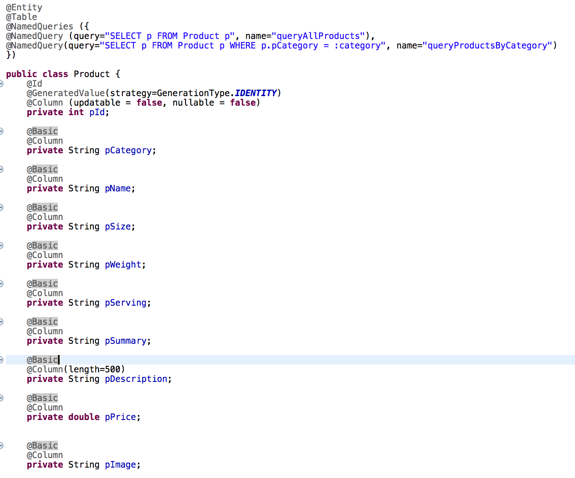
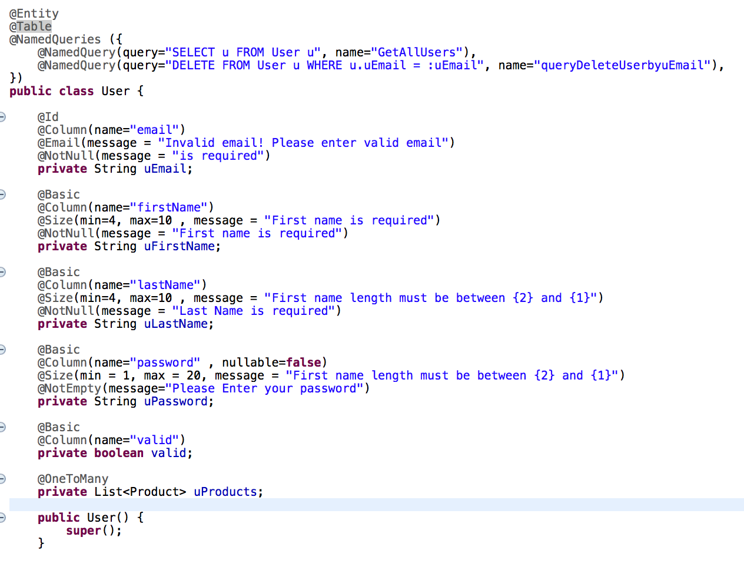
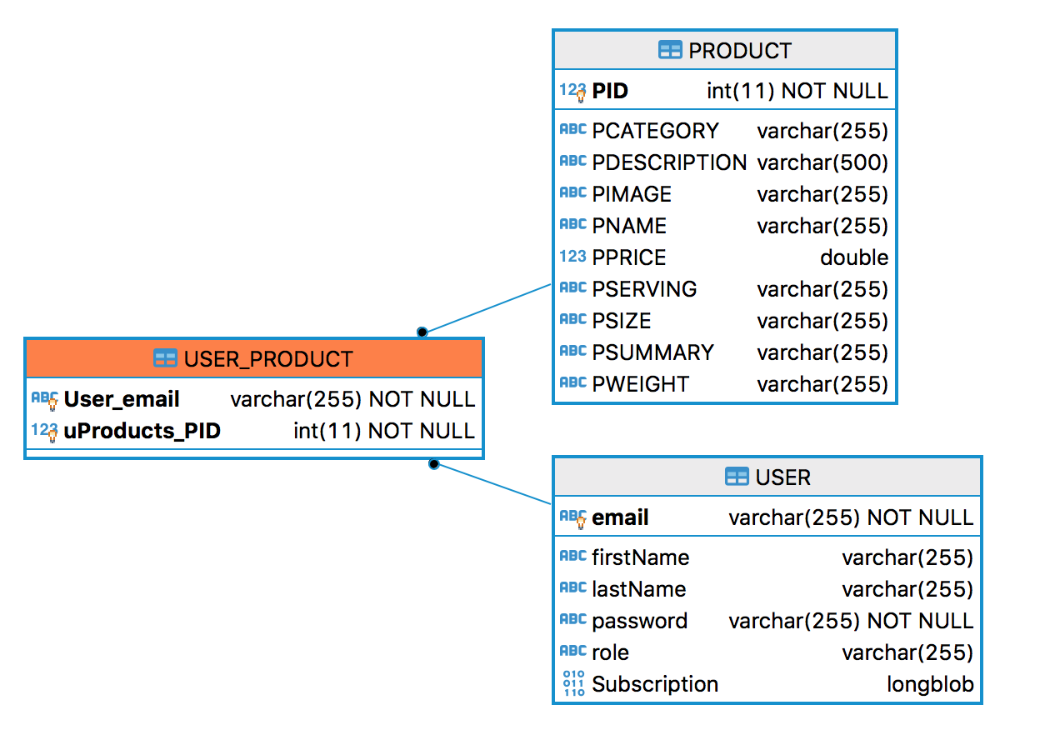
ERD diagram
public class User
public class Product

Slide 11
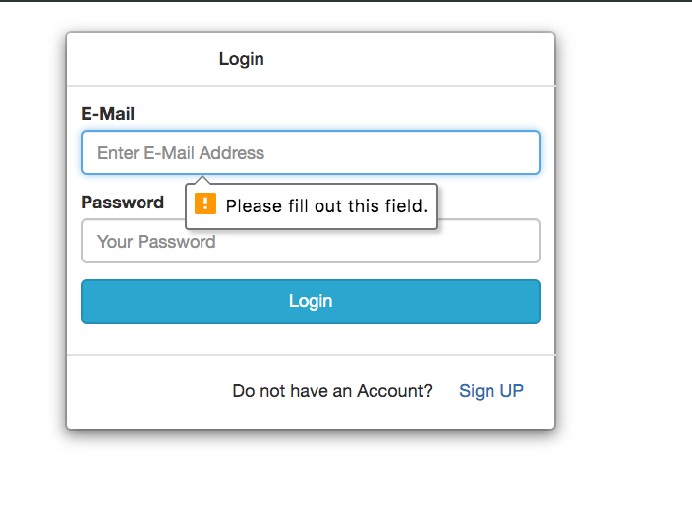
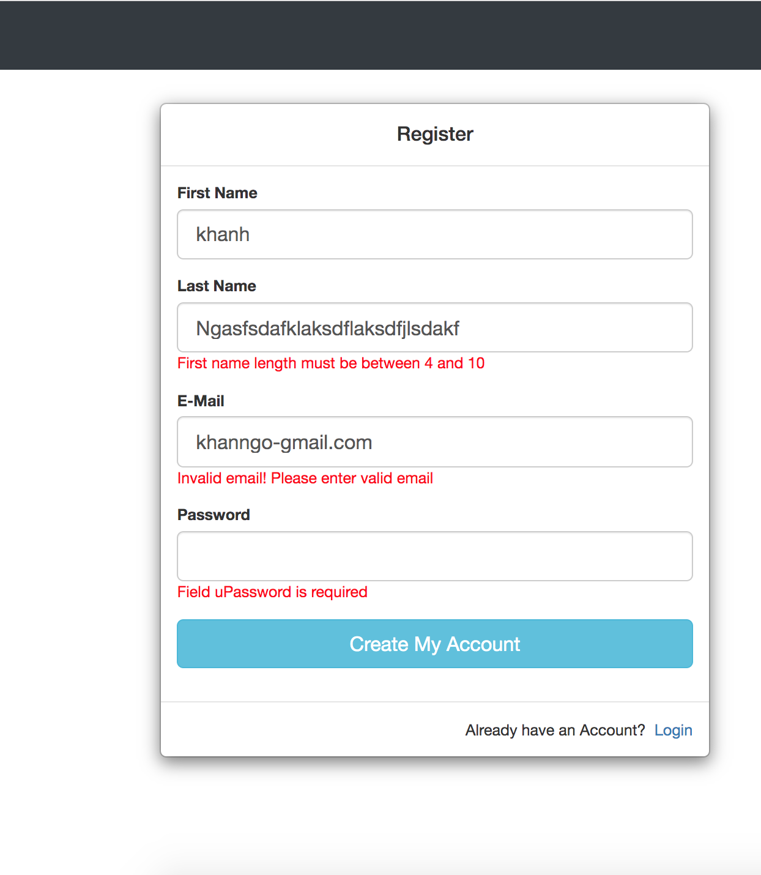
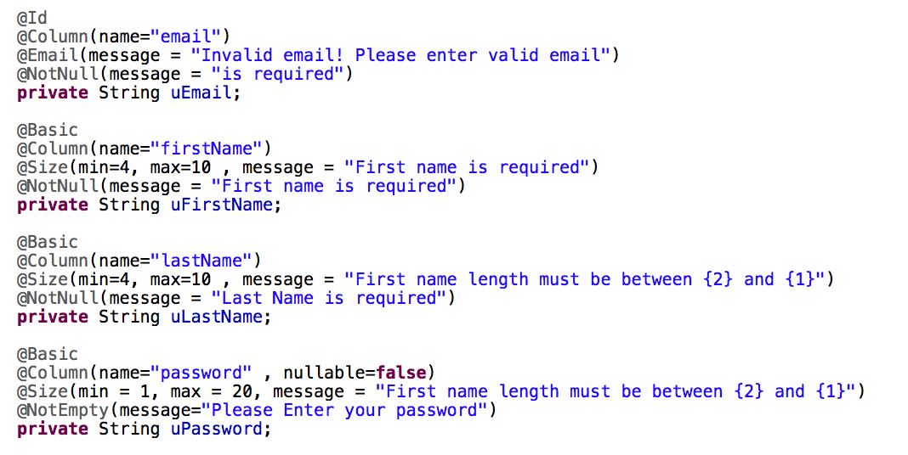
Login / Registration with Validation
Login HTML form validation:
input type attribute
input requires attribute
Registration spring validation:

Slide 12
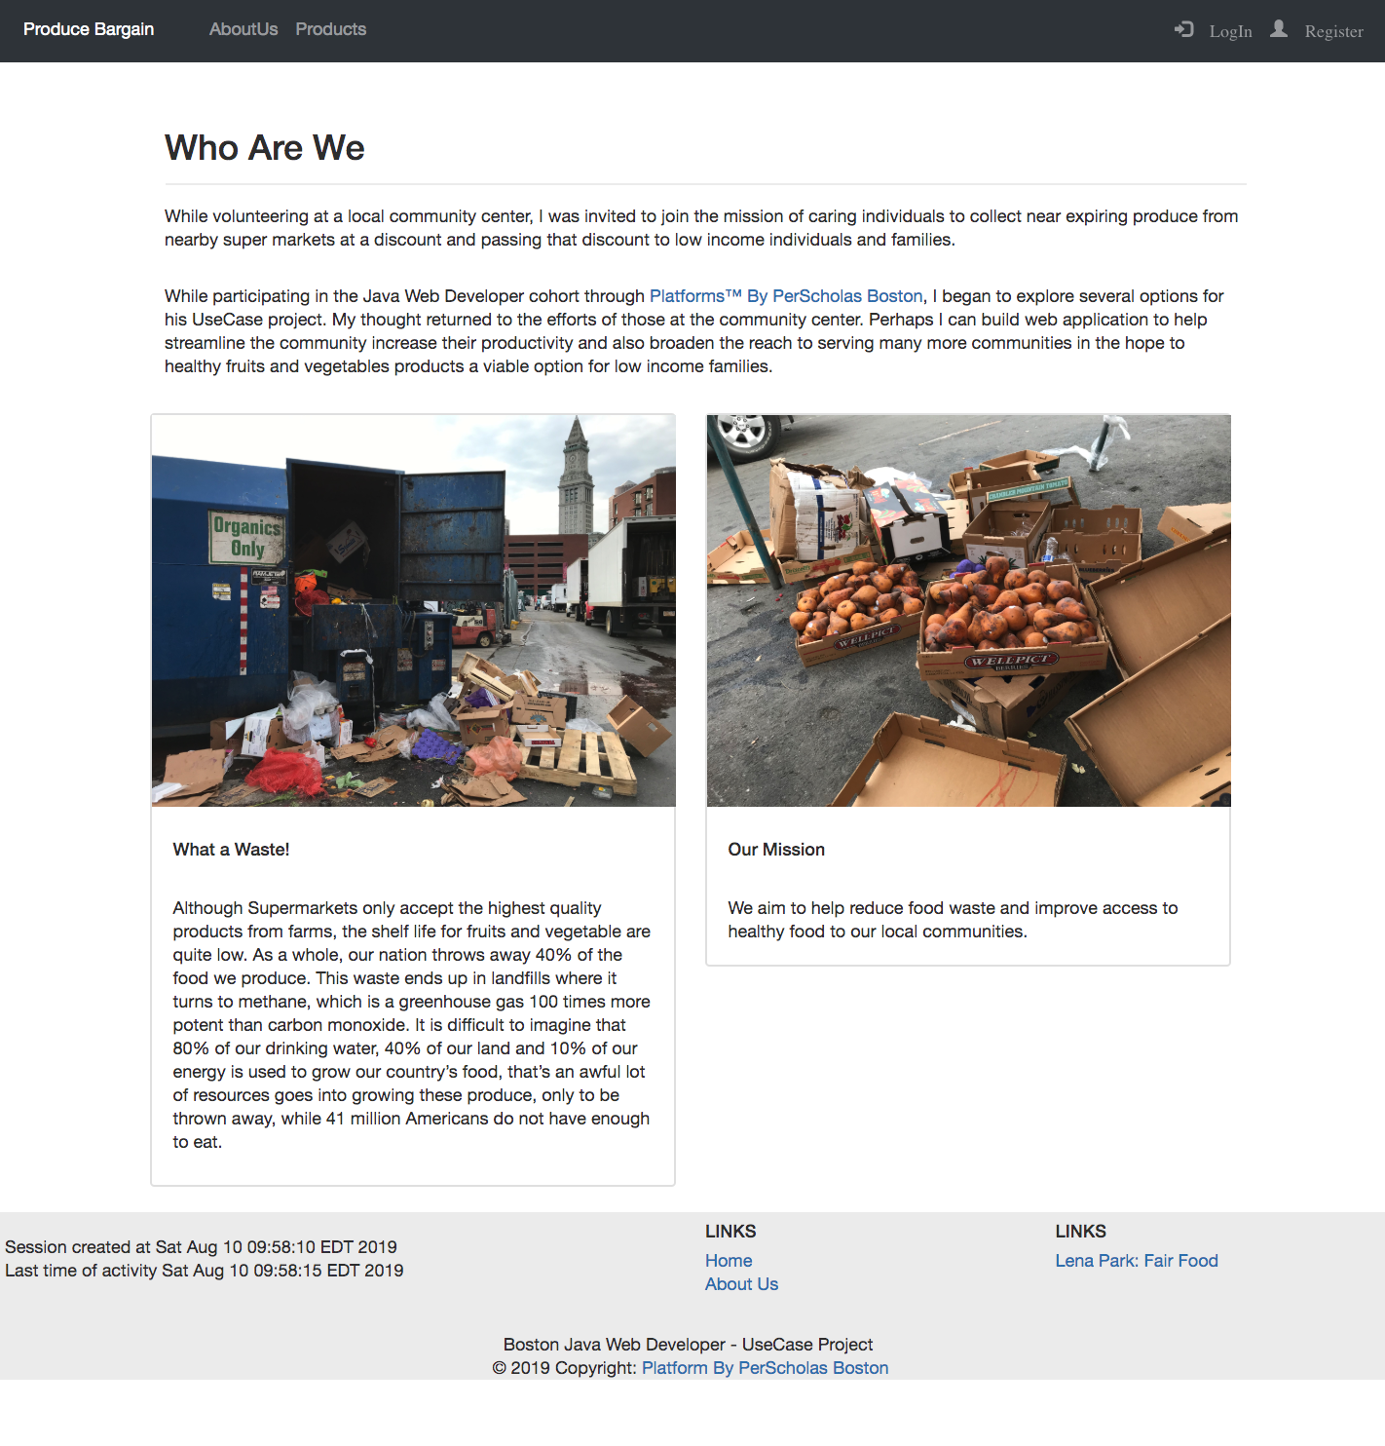
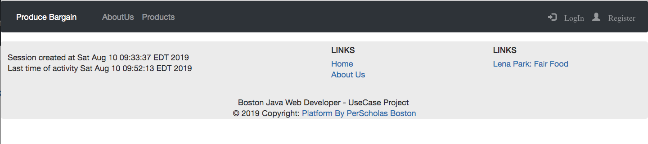
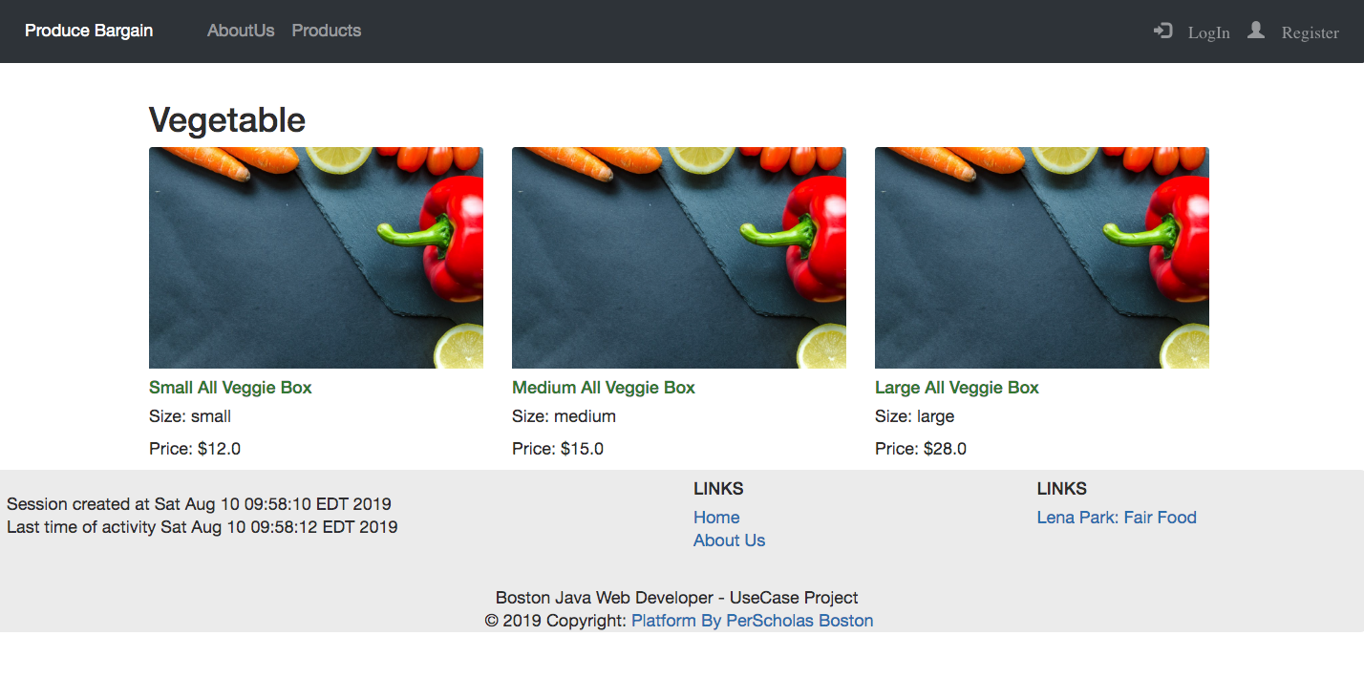
Access without Login
Access is limited to
About Us
Products (no “Add To Cart”)
Login
Register

Slide 13
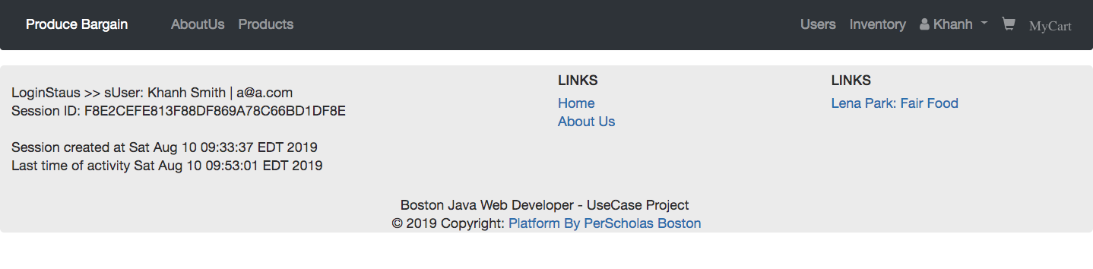
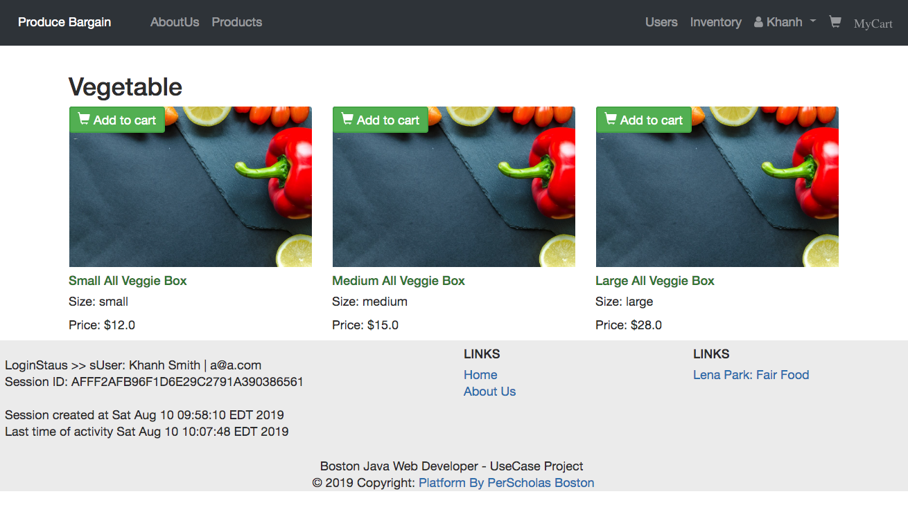
Logged
In
Session and User Information
Users
Product Inventory
Profile (profile /logout)
Cart
access to “Add to Cart”

Slide 14
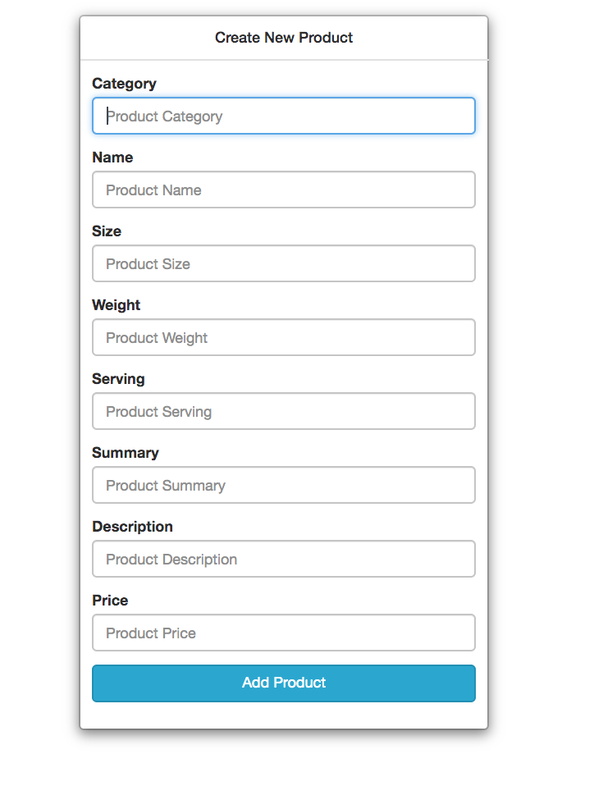
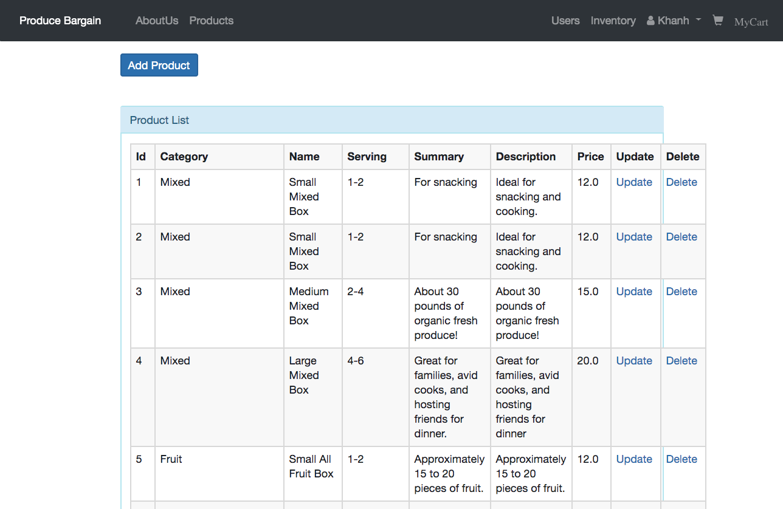
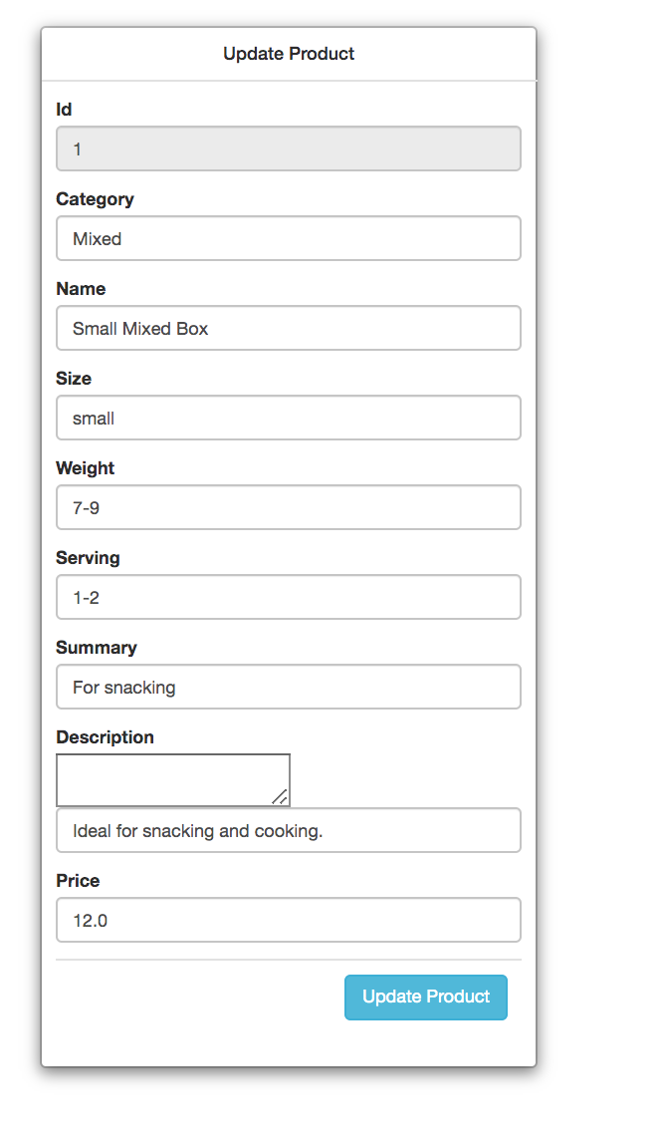
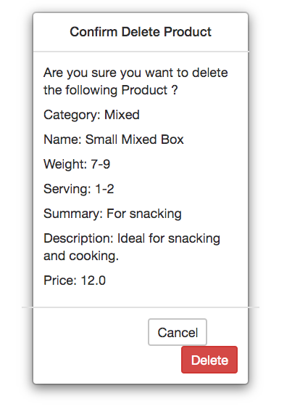
C
R
Create: Add Product
input form will fields
to create new User
Read: getAllProduct() retreives all all products from products table
U
D
Update: Data pertaining to
the user is prefilled on the
update user form
Delete: Data of the product is presented to confirm the delete

Slide 15
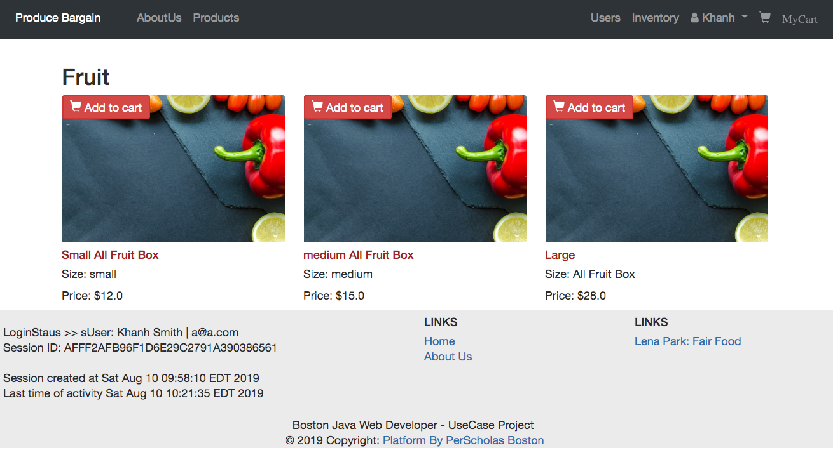
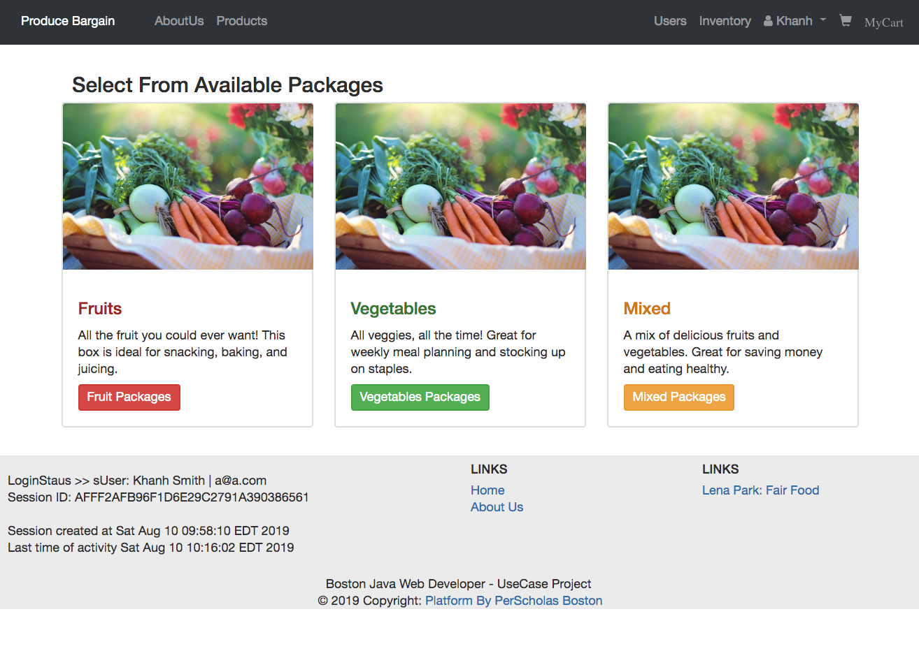
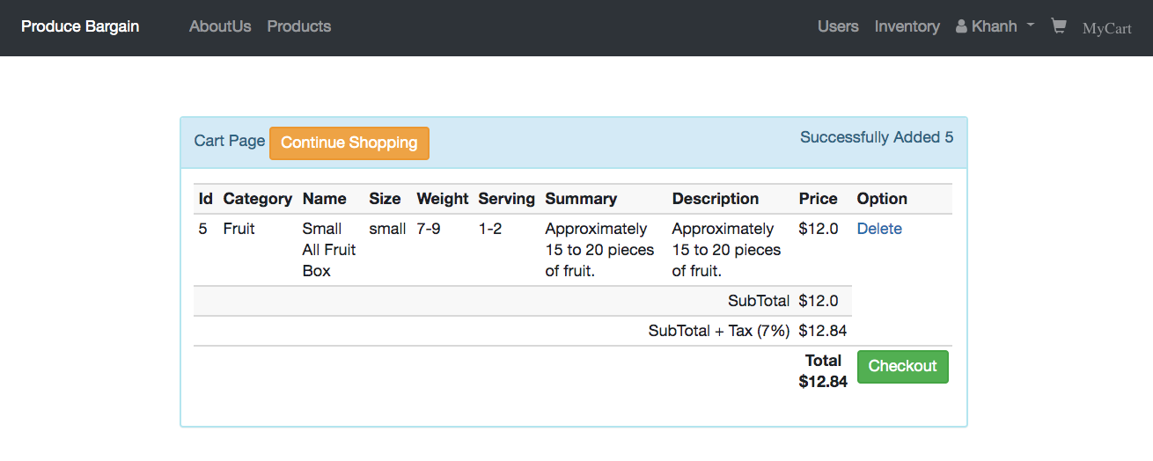
Shopping Experience
Selecting Size of Package
Available Packages
Subscripting added to Cart

Slide 16
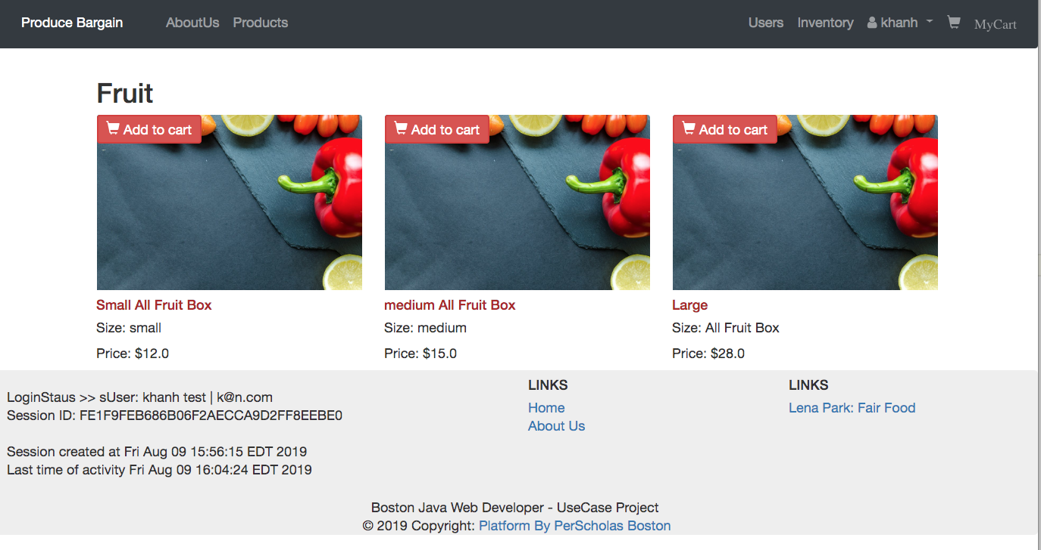
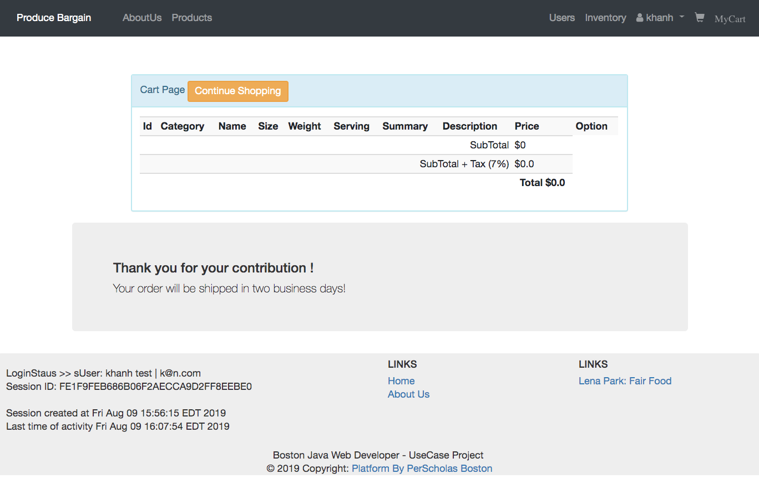
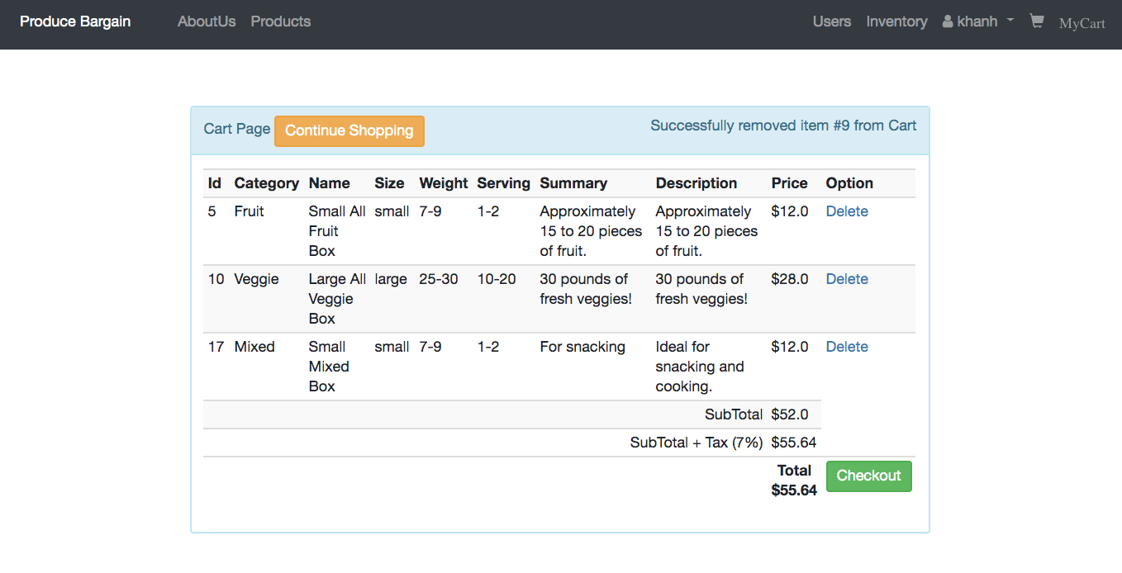
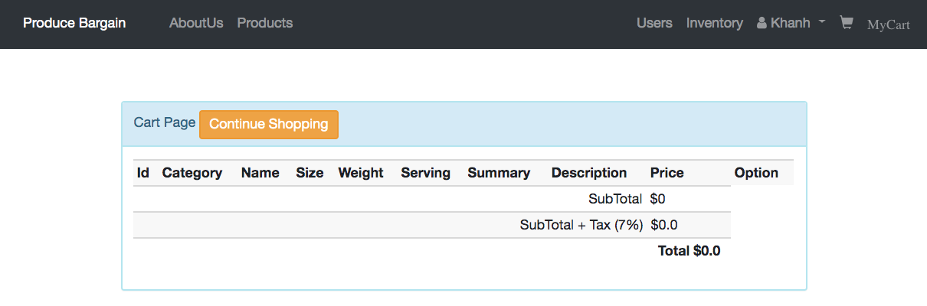
Subscription Added to Cart
Check Out
Subscriptions Can Be Removed From Cart
Confirm that Cart is Empty After CheckOut

Slide 17
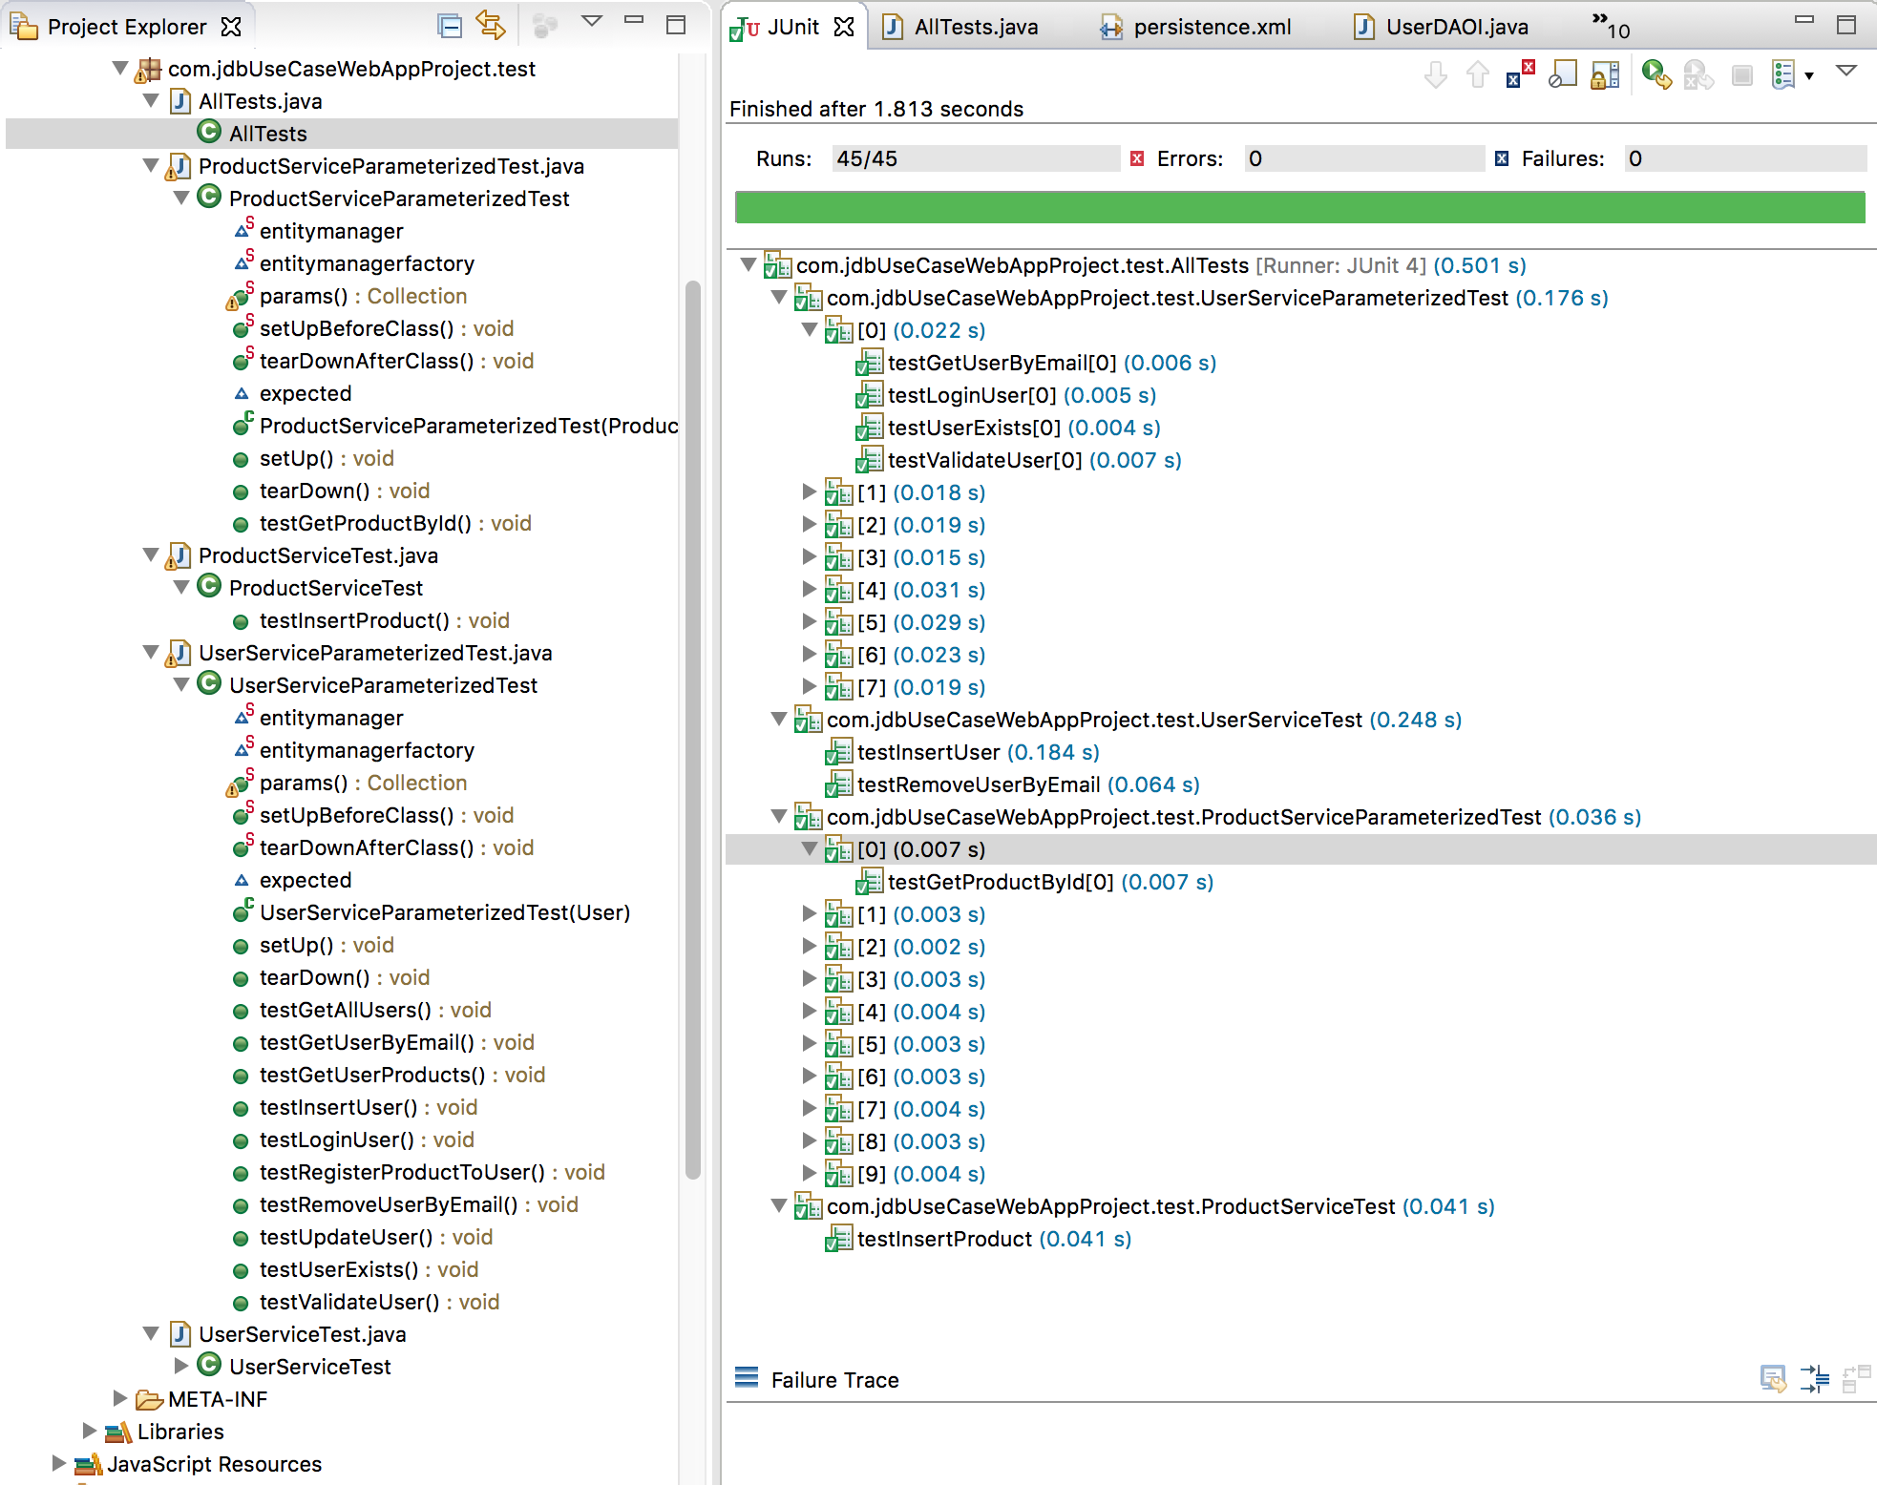
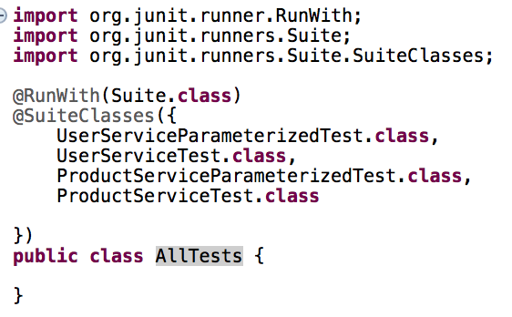
Testing with JUnit
Utilizing JUnit Test Suite
For test automation

Slide 18
Progression of Work
Sprint 0 (May 13 - May 24)
- Introduction to Agile / Scrum / Java Core
Technologies Stack
Spring MVC
Spring Validation
JPA
EclipseLink
JUnit
Maven - 3.2
BootStrap 4
HTML5
CSS3
javascript
Sprint 1 (May 27 - Jun 7)
- Java Core
Sprint 2 (Jun 10 - Jun 21)
- SQL
Sprint 3 (Jun 24 - Jul 5)
- JPA (Incoporated JPA components into
Sprint 4 (Jul 8 - Jul 19)
- Front-End (JQuery, Bootstratp, HTML, CSS)
Sprint 5 (Jul 22 - Aug 2)
- Servlets, Spring MVC

